Slide 1
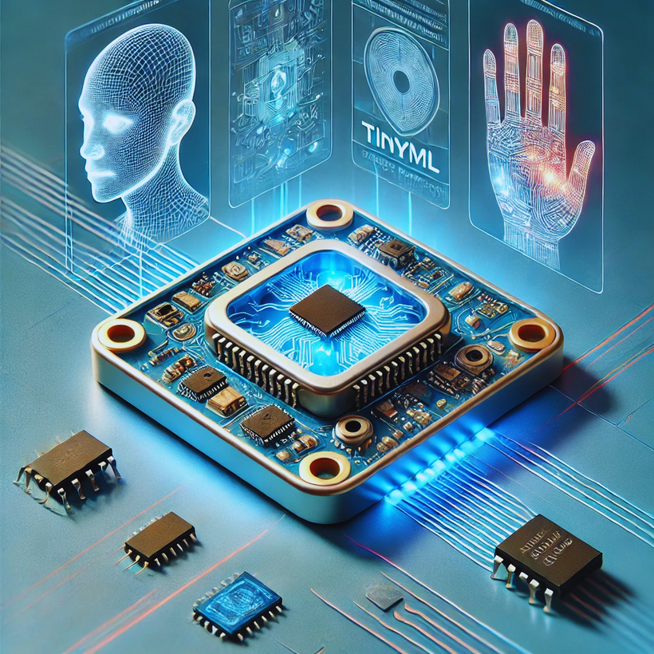
Introducing
FaceSafe
On-Device Authentication
& Gesture Recognition
Embracing TinyML for Privacy and Efficiency
Team: Sleeping-Buddha
Member: Afsara Benazir, Shafat Shahnewaz, Samit Hasan
Powered by: XIAO ESP32S3 Sense

Slide 2
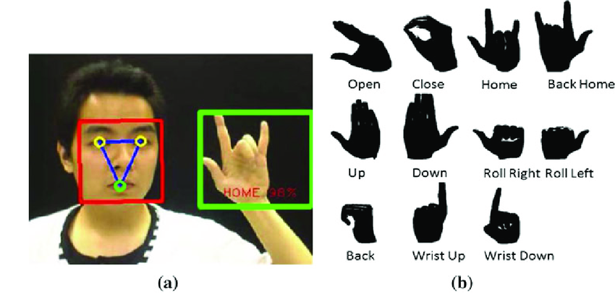

Embracing TinyML for Privacy and Efficiency
Recognize individual face for authentication and gestures for action identification.
Key Objectives:
Privacy
Low Power & High Efficiency
Real-Time Responsiveness
Usability
Classroom attendance
Smart Home features
Notes:
Privacy: On-device processing ensures facial data and gesture inputs are never sent to the cloud, protecting user privacy.
Low Power & High Efficiency: Optimized for edge devices, TinyML models run on minimal power, making them suitable for battery-powered or low-power systems.
Real-Time Responsiveness: In-device inference reduces latency, enabling instantaneous user interactions.

Slide 3
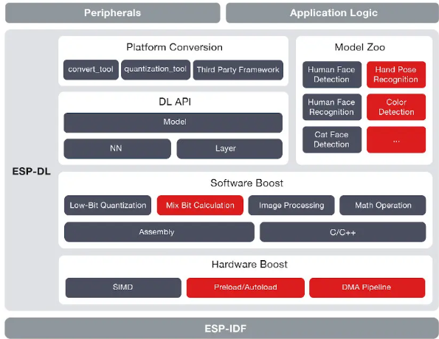
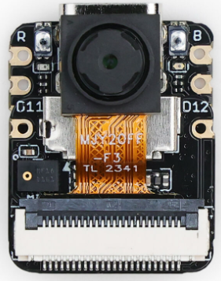
Seeed Studio XIAO ESP32S3: Powering TinyML On-Device Processing
Core Specs of ESP32S3:
Dual-core Tensilica LX7
240 MHz Frequency
512KB SRAM & 8MB Flash
Additional Peripherals:
Integrated Wi-Fi and Bluetooth
Built-in Camera Support
21 mm
17.5 mm
ESP-DL provides APIs for Neural Network (NN)ference, Image Processing, Math Operations and Deep Learning Models.

Slide 4
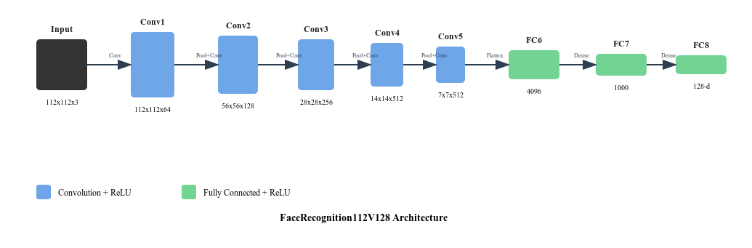
Models Deployed
Face Detection Model
At first a two -stage face detection model is identified two place a rectangular box around the face so that the input of face recognition is reduced.
Face Recognition Model
A deep neural network model employs convolutional layers and depth wise separable convolutions to extract and encode facial features into a compact, 128-dimensional embedding
Hand Gesture Detection
For hand recognition we used Swift YOLO model which is a variation of the YOLO (You Only Look Once) object detection algorithm tailored for lightweight and efficient real-time inference.

Slide 5
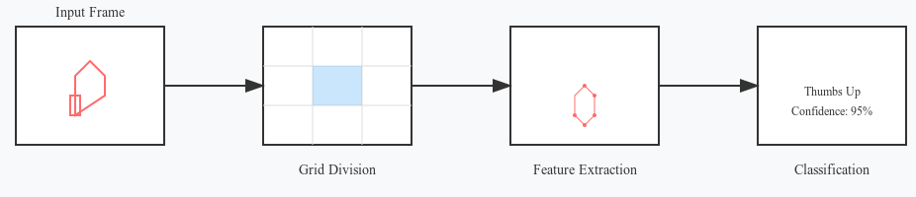
Gesture recognition
SenseCraft AI framework
Rock paper scissors
Left/right hand recognition
More compatible
Espressif
Less compatible
Challenges in deploying, doesn't take streaming data

Slide 6
Path to Success: Key Steps in Project Development
1. Hardware Setup:
2. Software Setup:
3. Camera and Model Integration:
4. Deployment of User Interface:
5. Gesture Recognition Pipeline:
Installation of camera, antenna, and microSD card.​
Configuration of WiFi antenna
Verification of hardware functionality
Installation Arduino IDE for code development.
Upload initial firmware to test the camera module functionality.
Mapping of the GPIO pins with the camera slot for seamless communication.
Enabling PSRAM to support larger images.
Capturing images using the ESP32-S3 camera.
Configuring the system to push captured images as inputs to the image classification model for face recognition.
Tuning the system for efficient picture capture and classification.
Deploying a web-browser-based GUI for a user-friendly experience.
Live video stream enabling via the camera feed.
GUI functionality integration over WiFi, allowing seamless user access.
Integration of the gesture recognition model after face recognition.
Configuring the system to transition from face detection to gesture recognition for actionable insights.
Notes:
Privacy: On-device processing ensures facial data and gesture inputs are never sent to the cloud, protecting user privacy.
Low Power & High Efficiency: Optimized for edge devices, TinyML models run on minimal power, making them suitable for battery-powered or low-power systems.
Real-Time Responsiveness: In-device inference reduces latency, enabling instantaneous user interactions.

Slide 7
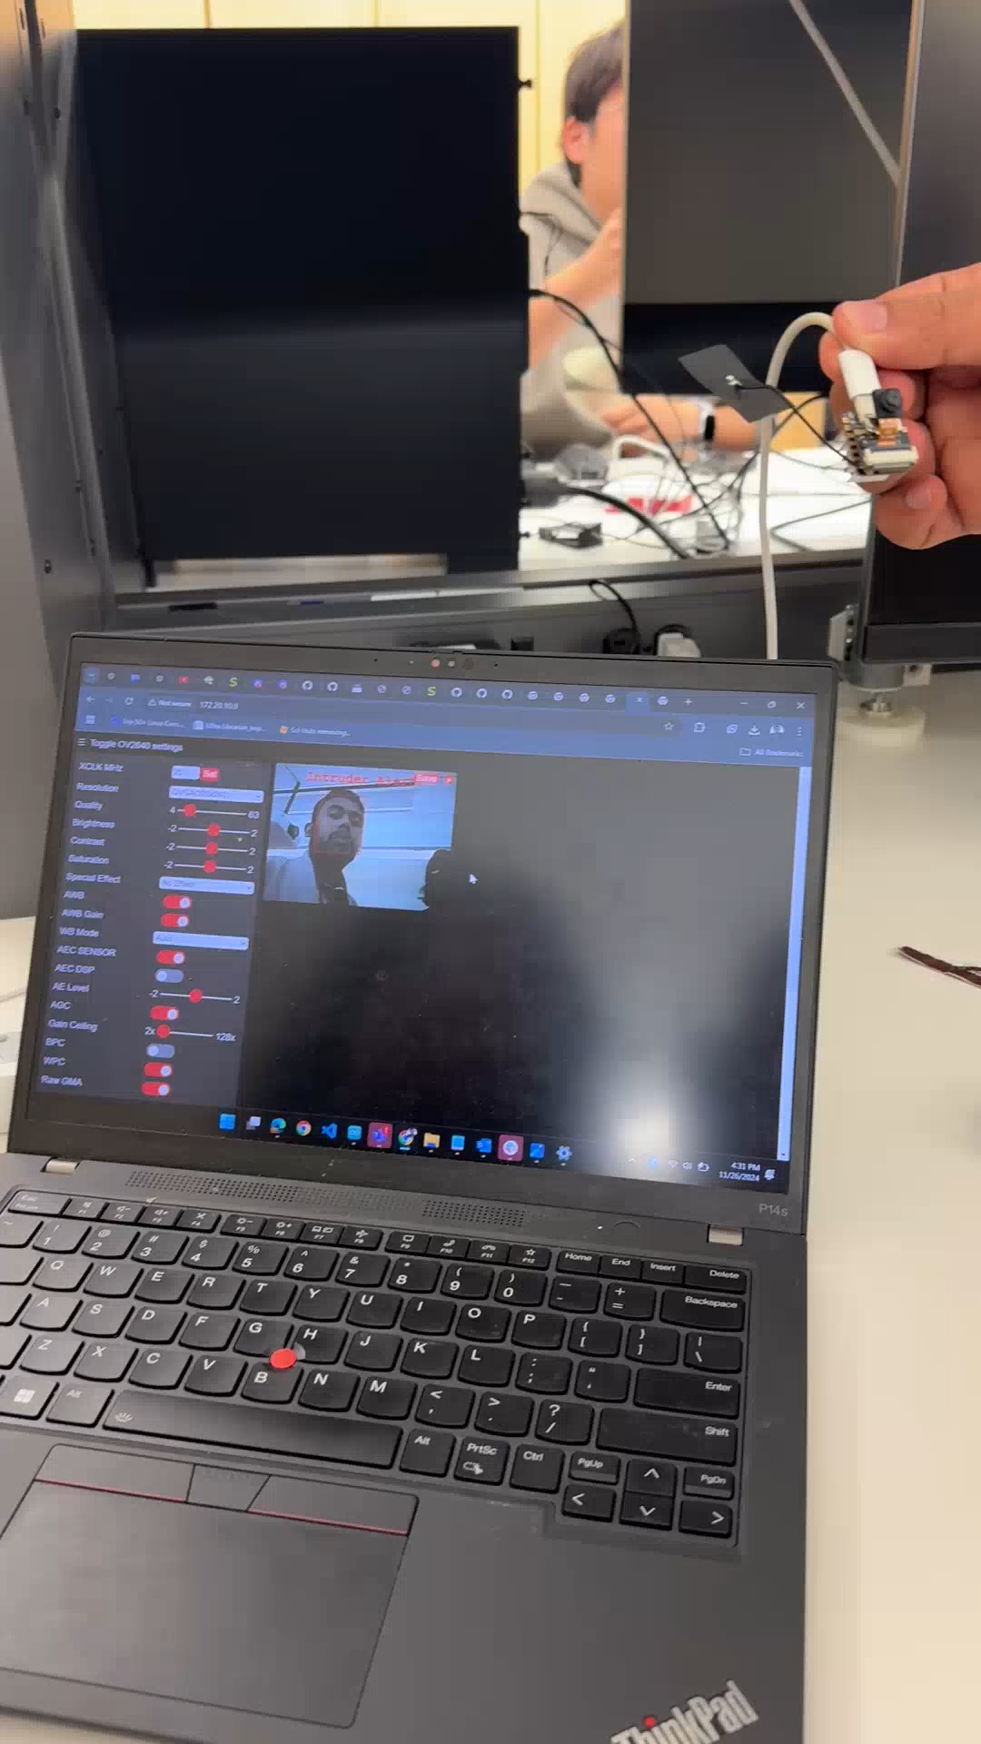
Demo video: Face detection & Recognition
Adds a rectangular box when face is detected.
If the face is recognized it shows a green box with associated ID and recognition accuracy
Category: Person ID, Intruder
Latency of recognition: ~0.7 sec
Current Consumption: ~341mA

Slide 8
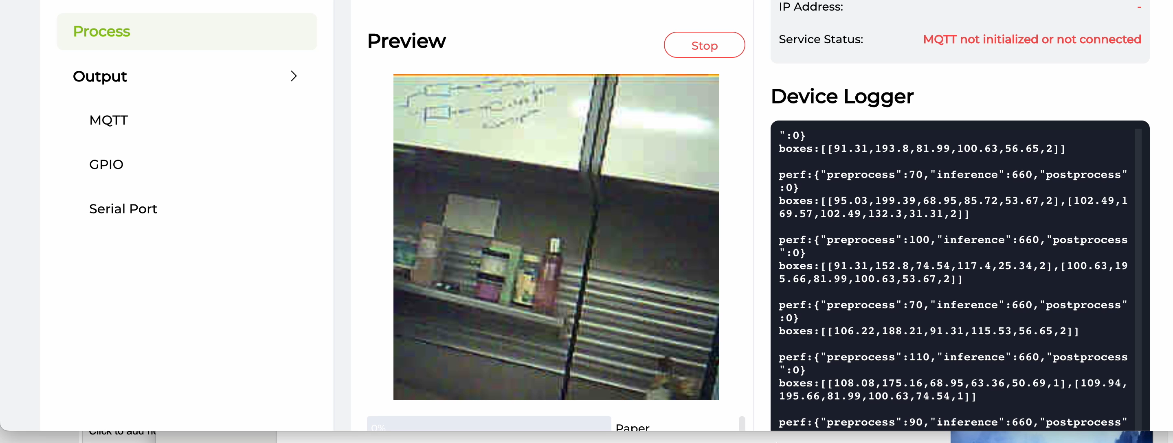
Demo video: Rock paper scissors
Takes in streaming video data

Slide 9
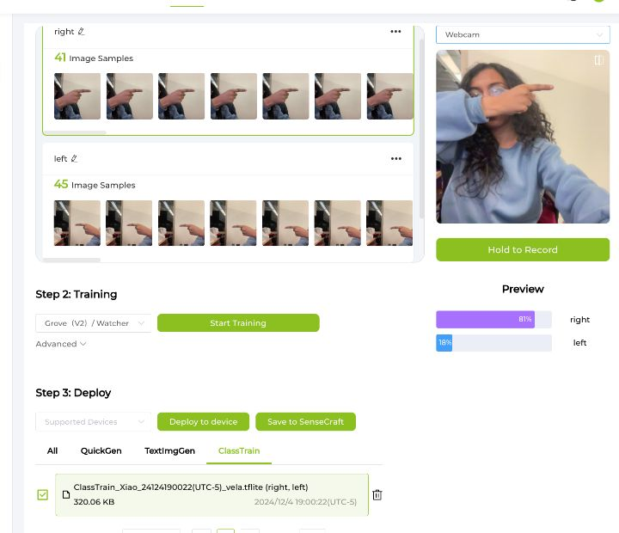
Demo: Left/right hand recognition
Train data: 86 image samples
Model: Swift-YOLO
Size: < 2MB
Latency: 700-800ms

Slide 10

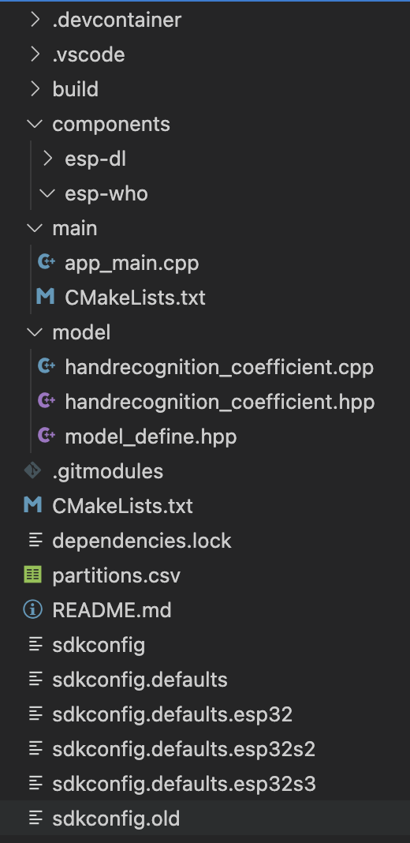
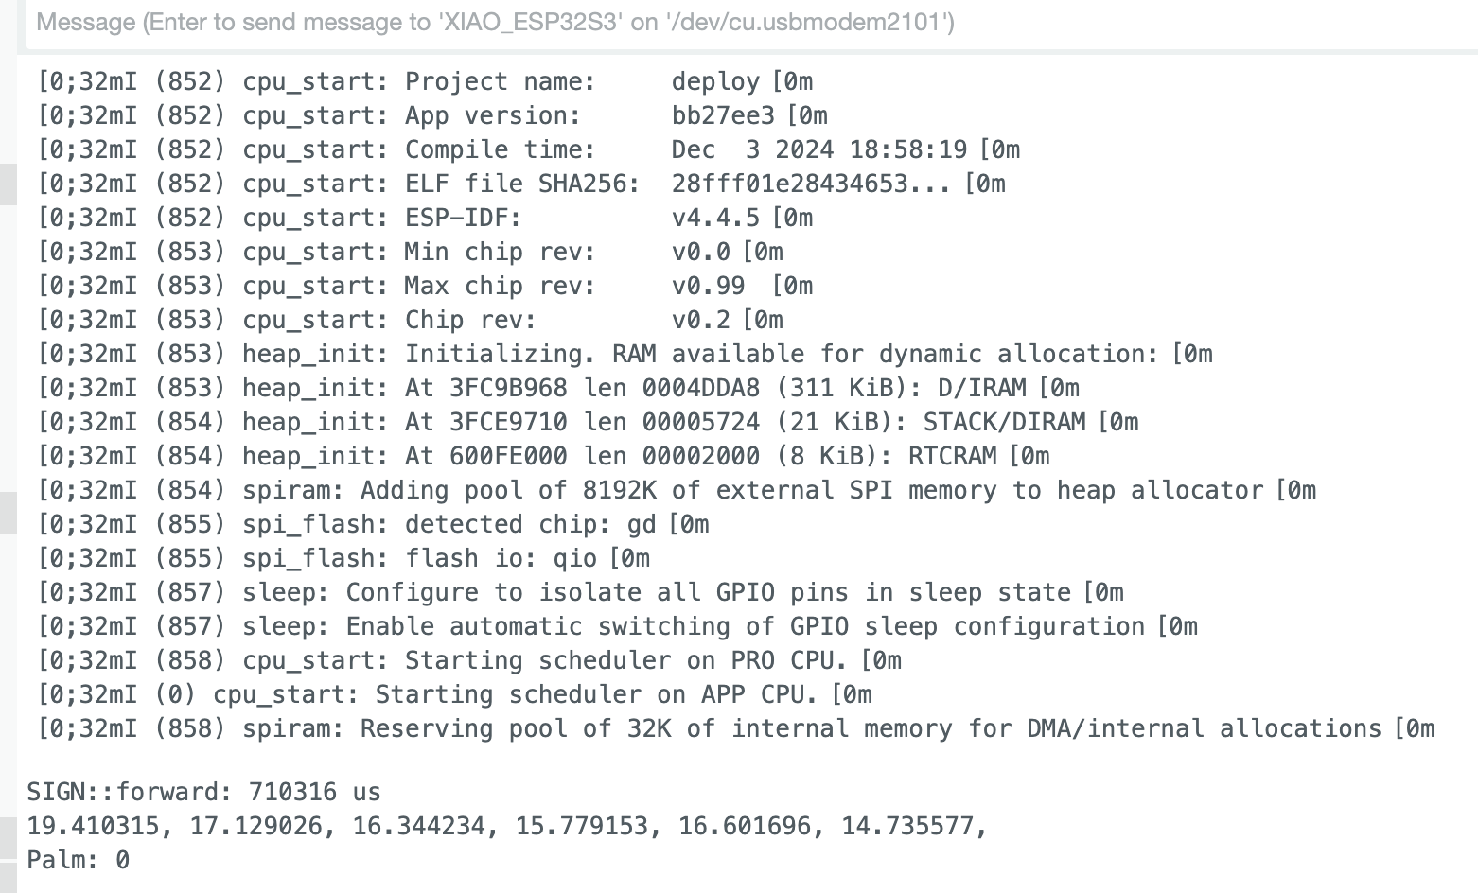

Espressif: Details and issues
Project directory and inference:

Slide 11
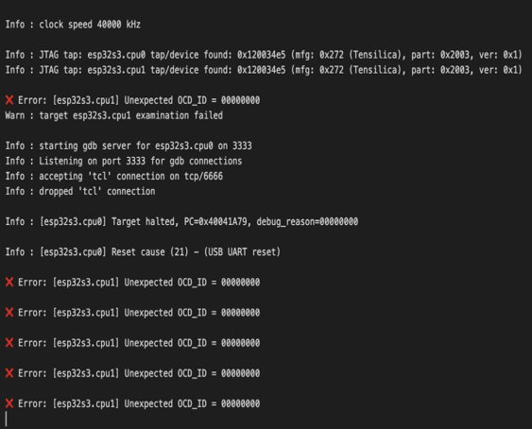
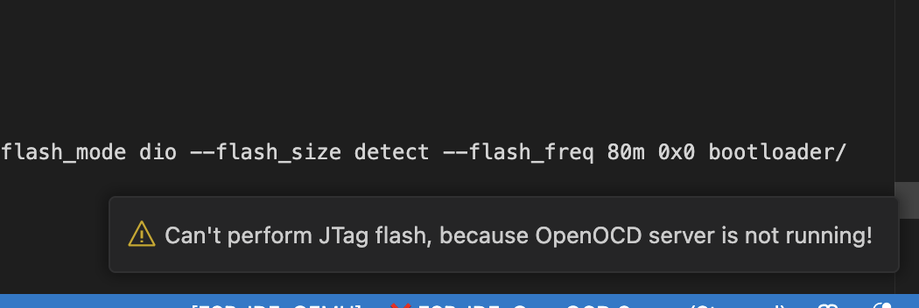
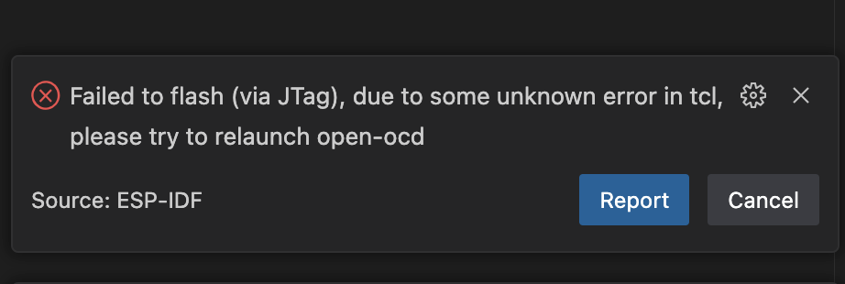
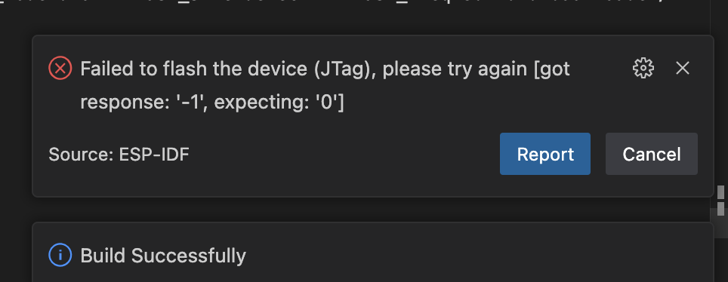
Challenges with Espressif: Flashing to device

Slide 12
Overall challenges
Setting up WiFi
Enabling streaming data – configuring GPIO port
Model Deployment: memory constraint, serial port connection
Made different choice of models
Resolved after bootloading multiple times
Thermal throttling
Soln: heat sink
Issue: always need to be reset
Acceptable given device constraint

